Slide 1
Improving Edge-Segmentation with Conditional Random Fields in U-Net Architectures
Dan Laurentiu, Babeș-Bolyai University
Project page: https://github.com/DanLaurentiu1/Attention-U-Net-with-CRF

Slide 2
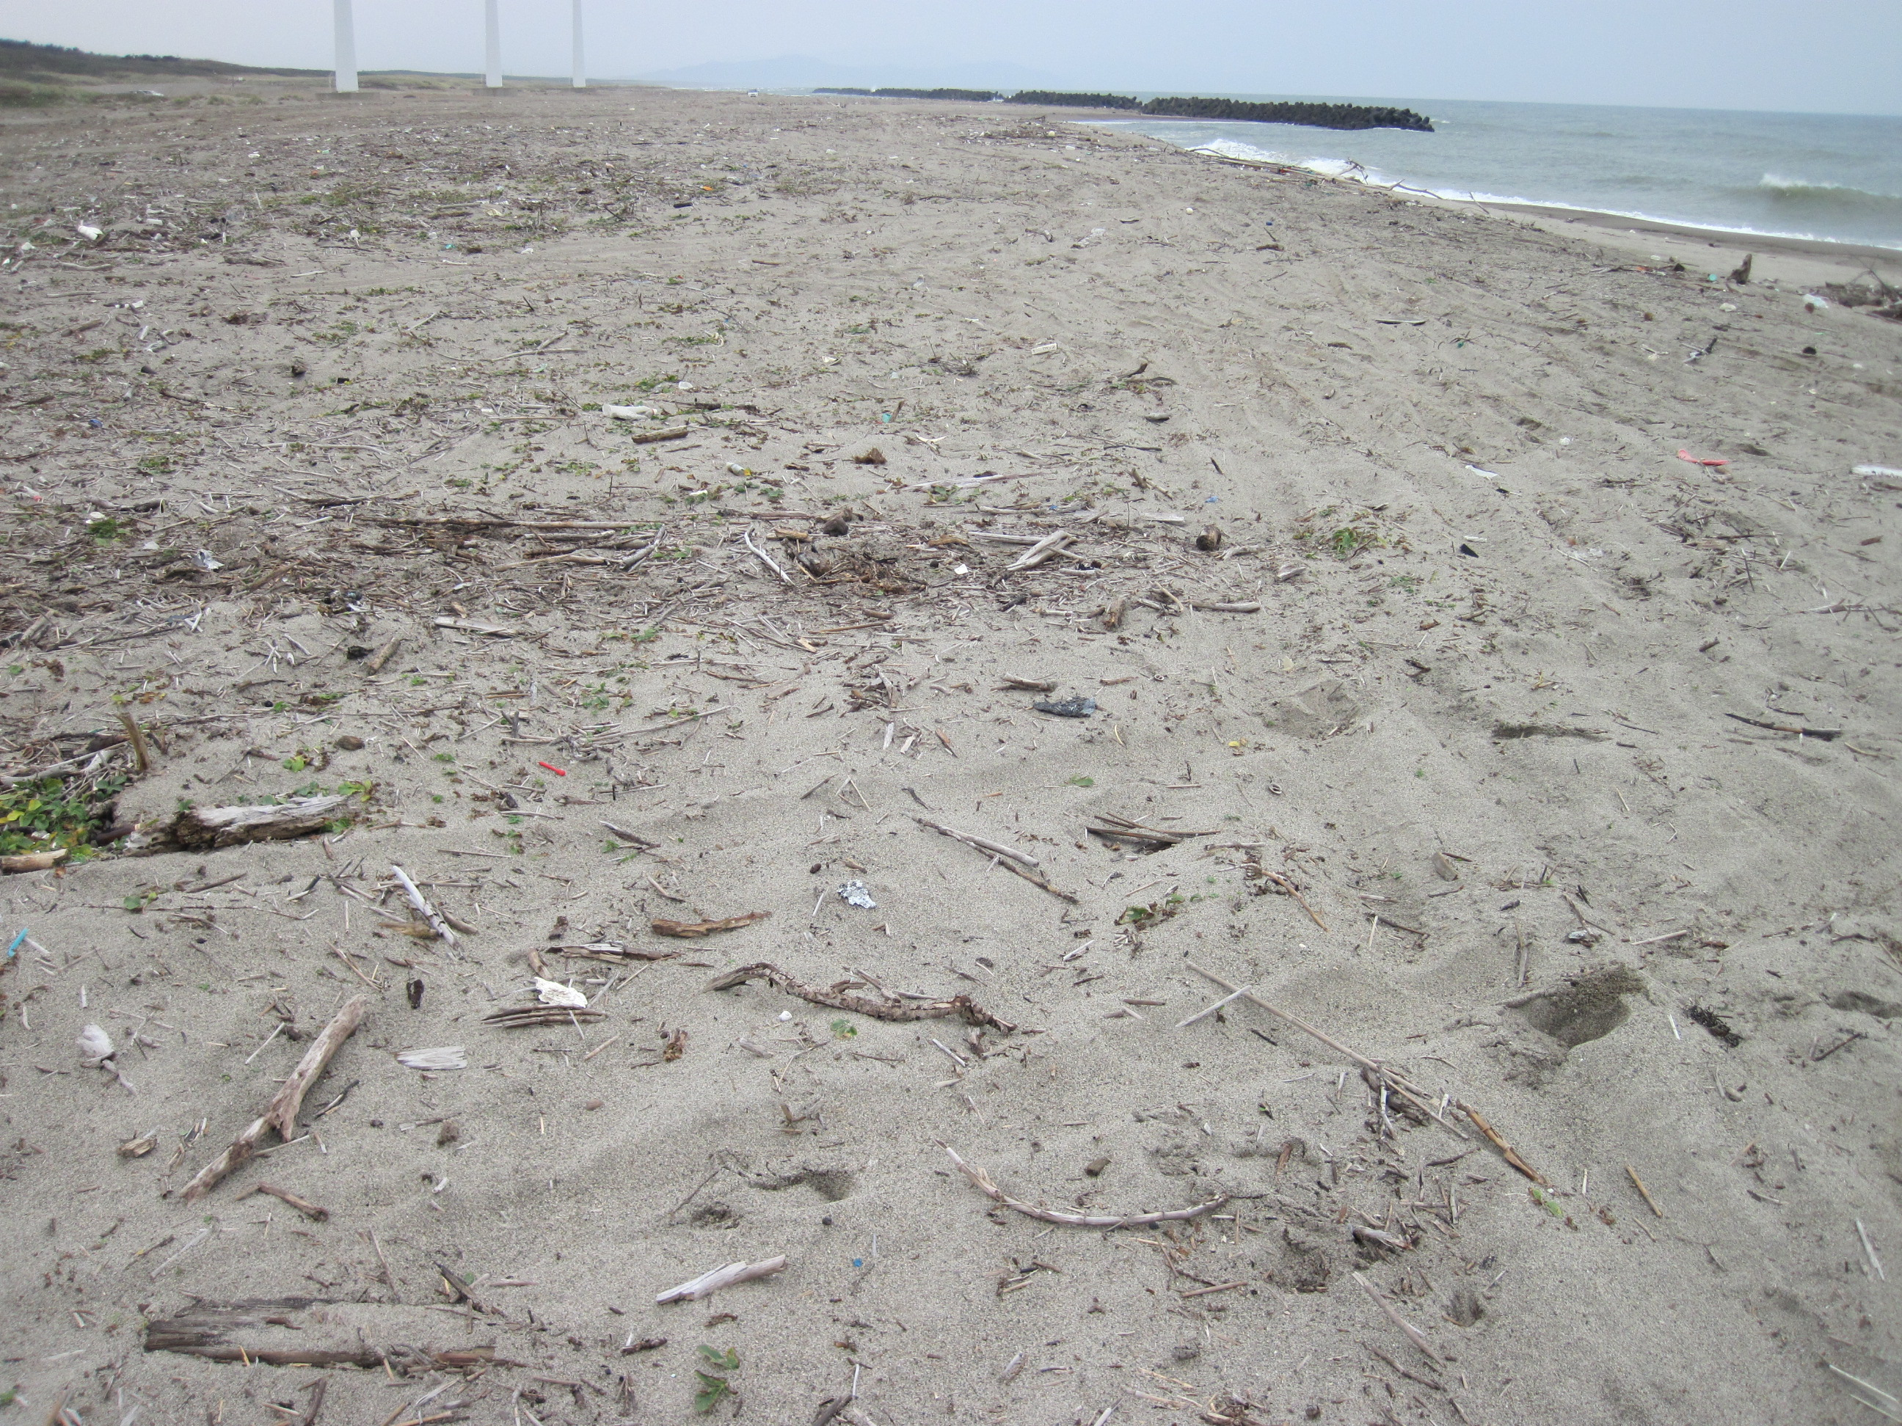
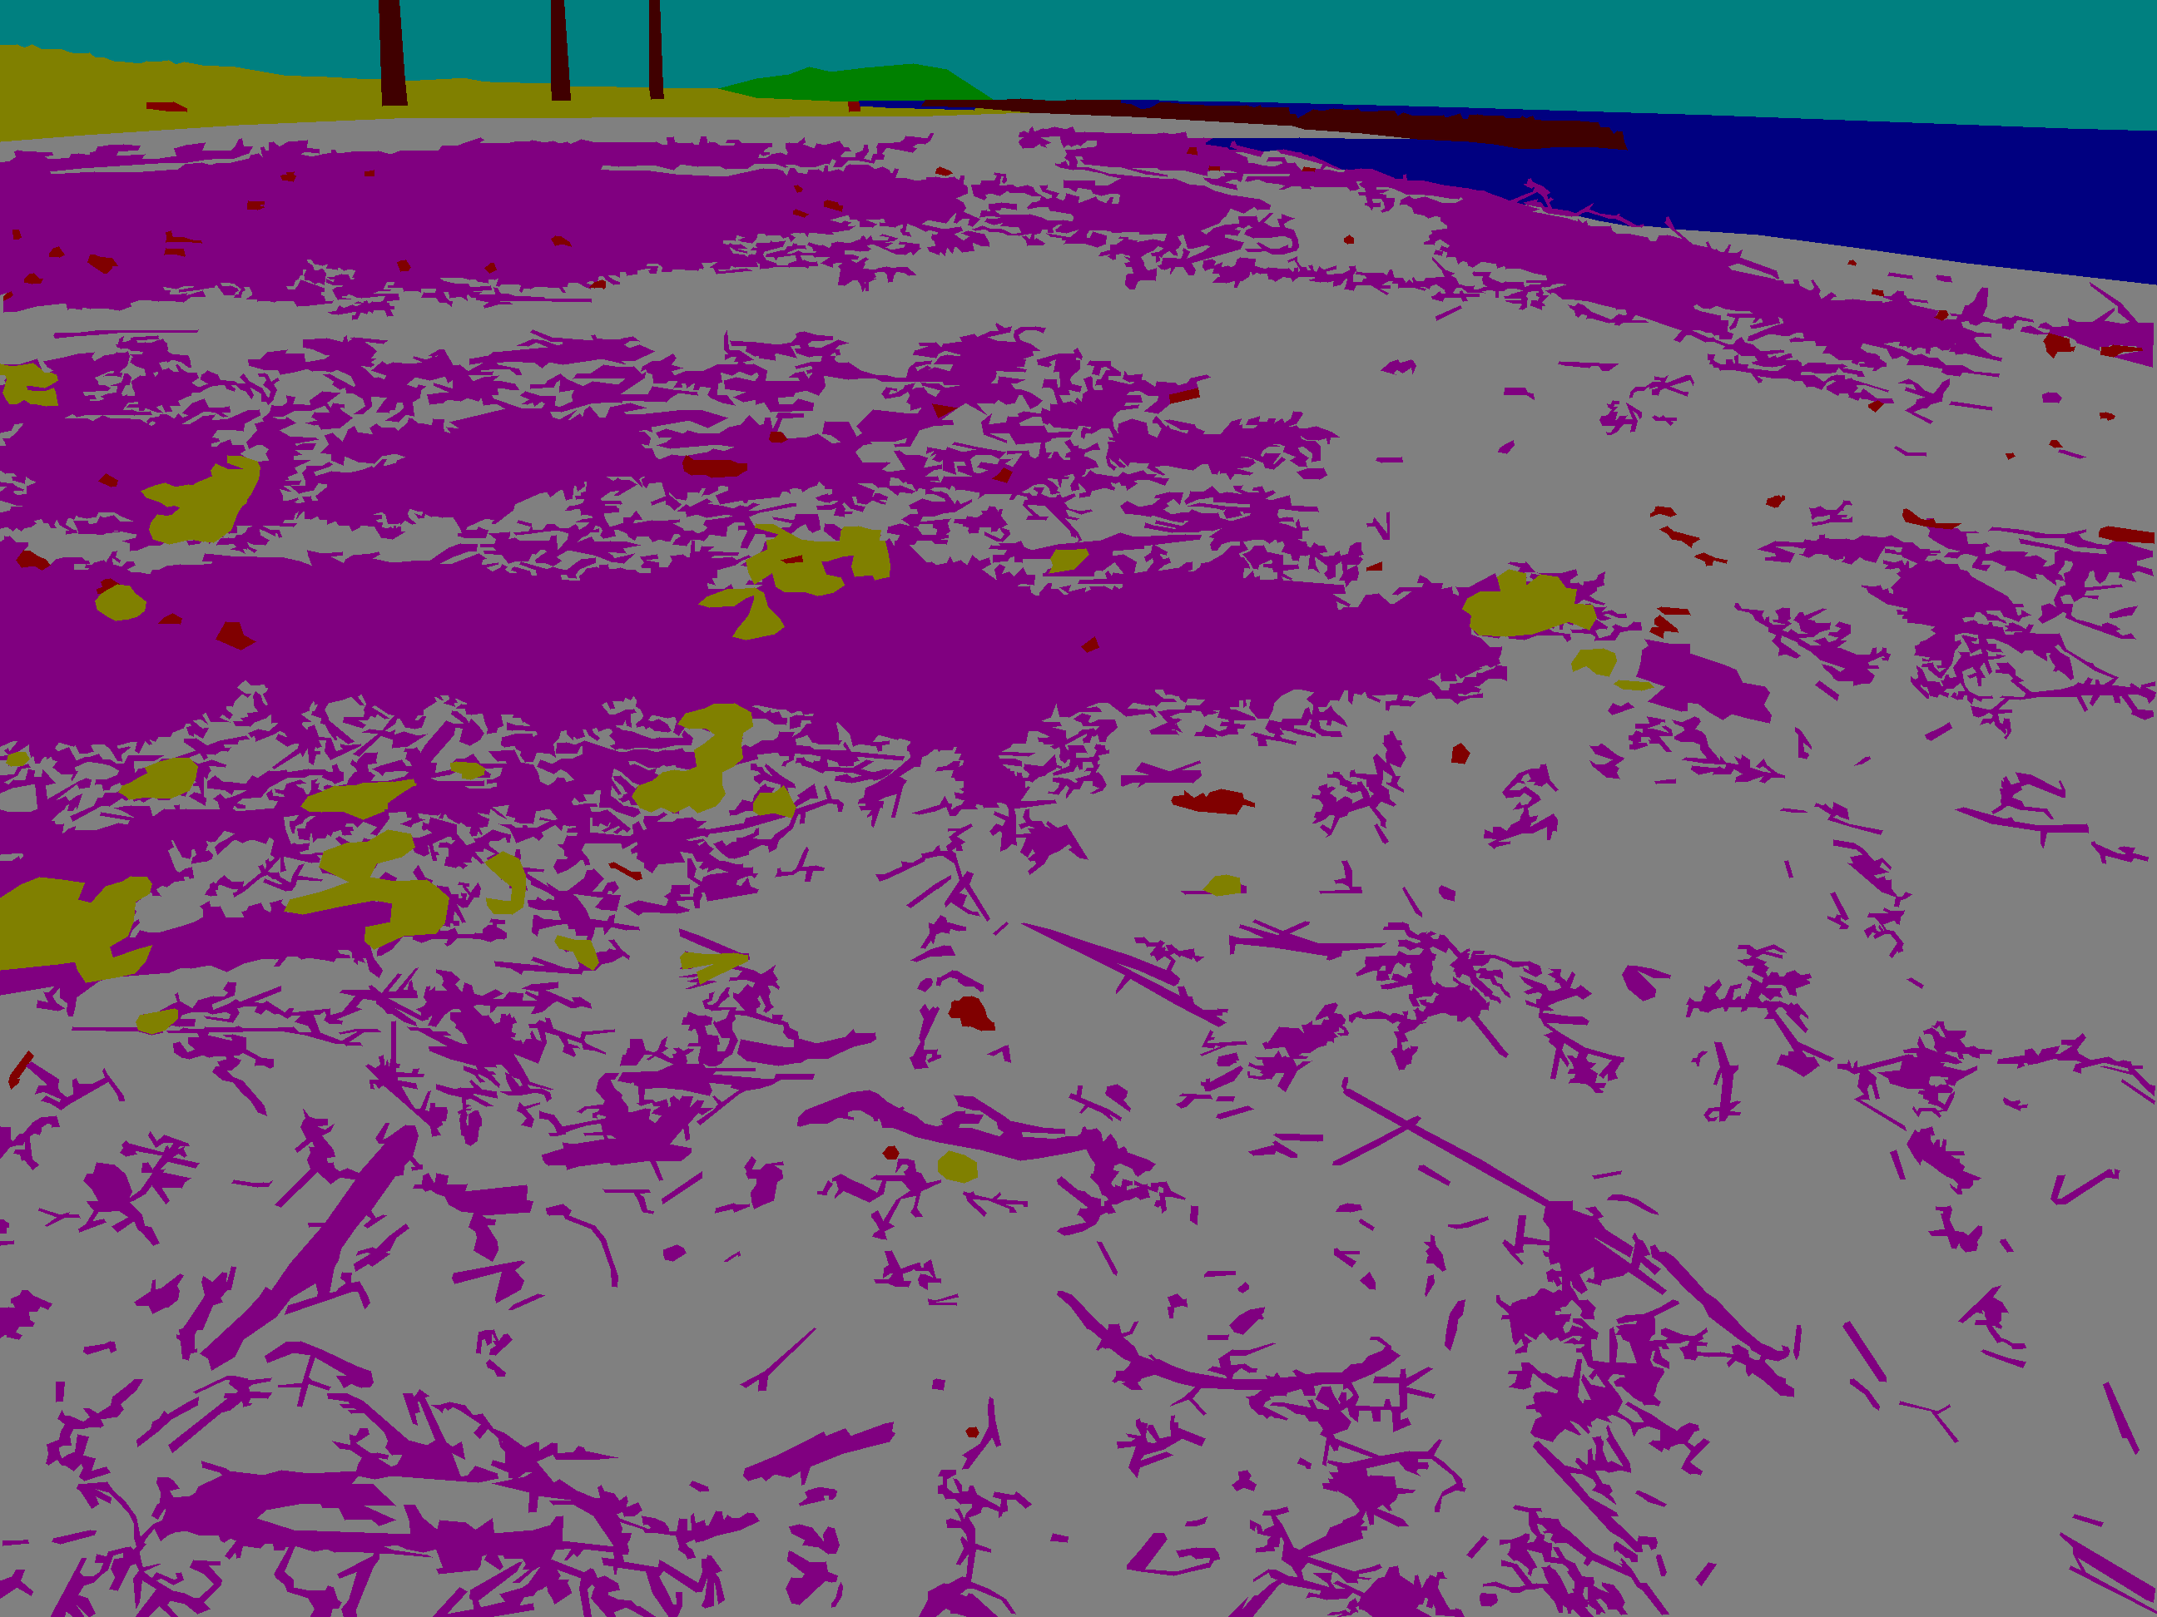
Motivation
There have been many examples of impressive segmentation using the lightweight U-Net model. However, this architecture still struggles with objects that are either: too small (in the background) or have complex boundaries.
The final goal of the project is to obtain segmentation masks that will more efficiently detect these exact pieces of litter, using conditional random fields.

Slide 3
Research Questions
What techniques can be used to make the U-Net model struggle less with segmenting fine, complex boundaries or small structures?
How do these techniques compare with the standard version of the U-Net model?

Slide 4
Background
Esme Yi -> “CRF U-Net for Medical Image Segmentation” 2019: achieves 78% IoU scores (using favorable dataset)
Sugiyama Daisuke -> “The BeachLitter Dataset v2022” 2022: interesting dataset for this specific problem
Dilsad Akkoyun -> “Identification and Detection of Beach Litter Using Computer Vision Techniques “ 2024: 73.8% IoU scores (beach litter dataset)

Slide 5
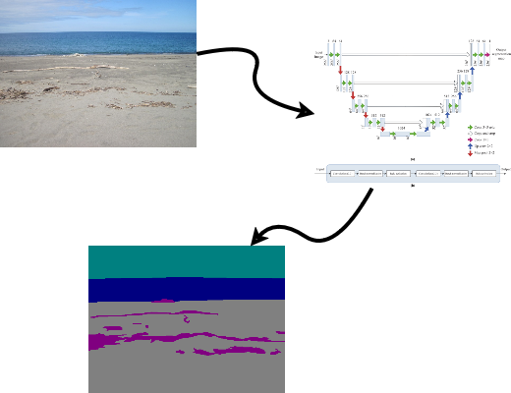
Methodology
Dataset was split into 80:20 ratio
Input images have 3-channels
Masks:
Binary -> scaled to 512x512, pixel value = 0 for litter, 1 for anything else
Multi-class -> scaled to 512, pixel values are from [0, nrClasses – 1]
Model: 4 layers, 18 conv3x3 operations, 4 up-conv2x2, 4 max pool 2x2
Batch size: 16
Epochs: 20

Slide 6
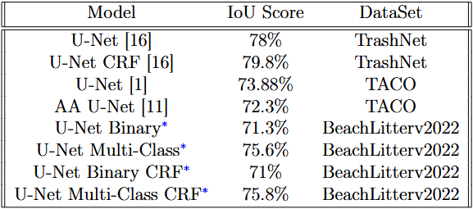



Results
While the IoU scores remain similar, some masks have slightly improved their edges
* -> this approach
Ground truth
Non-CRF
CRF

Slide 7
Conclusion
Some key challenges encountered were the lack of computational resources, with both of the models not fully converging
The experiments yielded promising results, with the binary U-Net model getting a 71.3 mean IoU score and 71 after the CRF post-processing. The multi-class results are better, due to the other, more prominent, classes such as: background, sky getting generally good scores.
At a high level, these methods can be improved significantly by: merging more specialized datasets together, eliminating some "bad" images from the BeachLitterv2022 dataset, using transfer learning and training the models more extensively.

